Slide 1
Good Morning
Take your name tag
Check-in

Slide 2
iClicker Question
What type of relationship (association) is this?
Strong Positive Association
Strong Negative Association
Non-linear Association

Slide 3
Evaluation Example
Please don’t rate yourself high on every assignment. Please rate fairly among your group members.
Example: your group has 4 people (each should, in theory, contribute 25% to the group).
First person:
Assignment 3+3.5: contribute 100% (was in charge of these assignments)
Assignment 4+4.5: contribute 0% (then she did not need to contribute to these ones)
Assignment 5: contribute 0% (then she did not need to contribute to this one)
Assignment 6: contribute 0% (then she did not need to contribute to this one)
Average contribution per assignment: (100% + 0% + 0% + 0%)/ (4 assignments) = 25%
Actual contribution: 25% (average contribution per assignment) / 25% (theoretical contribution in a group of 4) = 100%
Notes:
Since I feel like some of you might want to understand how I use your evaluation to grade your final report.
I will give an example to illustrate the process
Remember the contribution percentage per assignment is the average of all your peers.

Slide 4




Chapter 17: Analysis and Interpretation: Individual Variables Independently
Notes:
Today we will cover regression analysis with one variable

Slide 5
Learning Objectives
Distinguish between univariate and multivariate analyses
Describe frequency analysis
Describe descriptive statistics
Discuss confidence intervals for proportions and means
Overview the basic purpose of hypothesis testing

Slide 6
Data Analysis: Two Key Considerations
(1) Is the variable to be analyzed by itself (univariate analysis) or in relationship to other variables (multivariate analysis)?
(2) What level of measurement was used?
If you can answer these two questions, data analysis is easy…
Notes:
Reminder:
Descriptive analysis
Difference analysis
Association analysis
Then,
Regression analysis
So to decide on which analysis you can carry out, you first have to ask yourself is the variable to be …

Slide 7
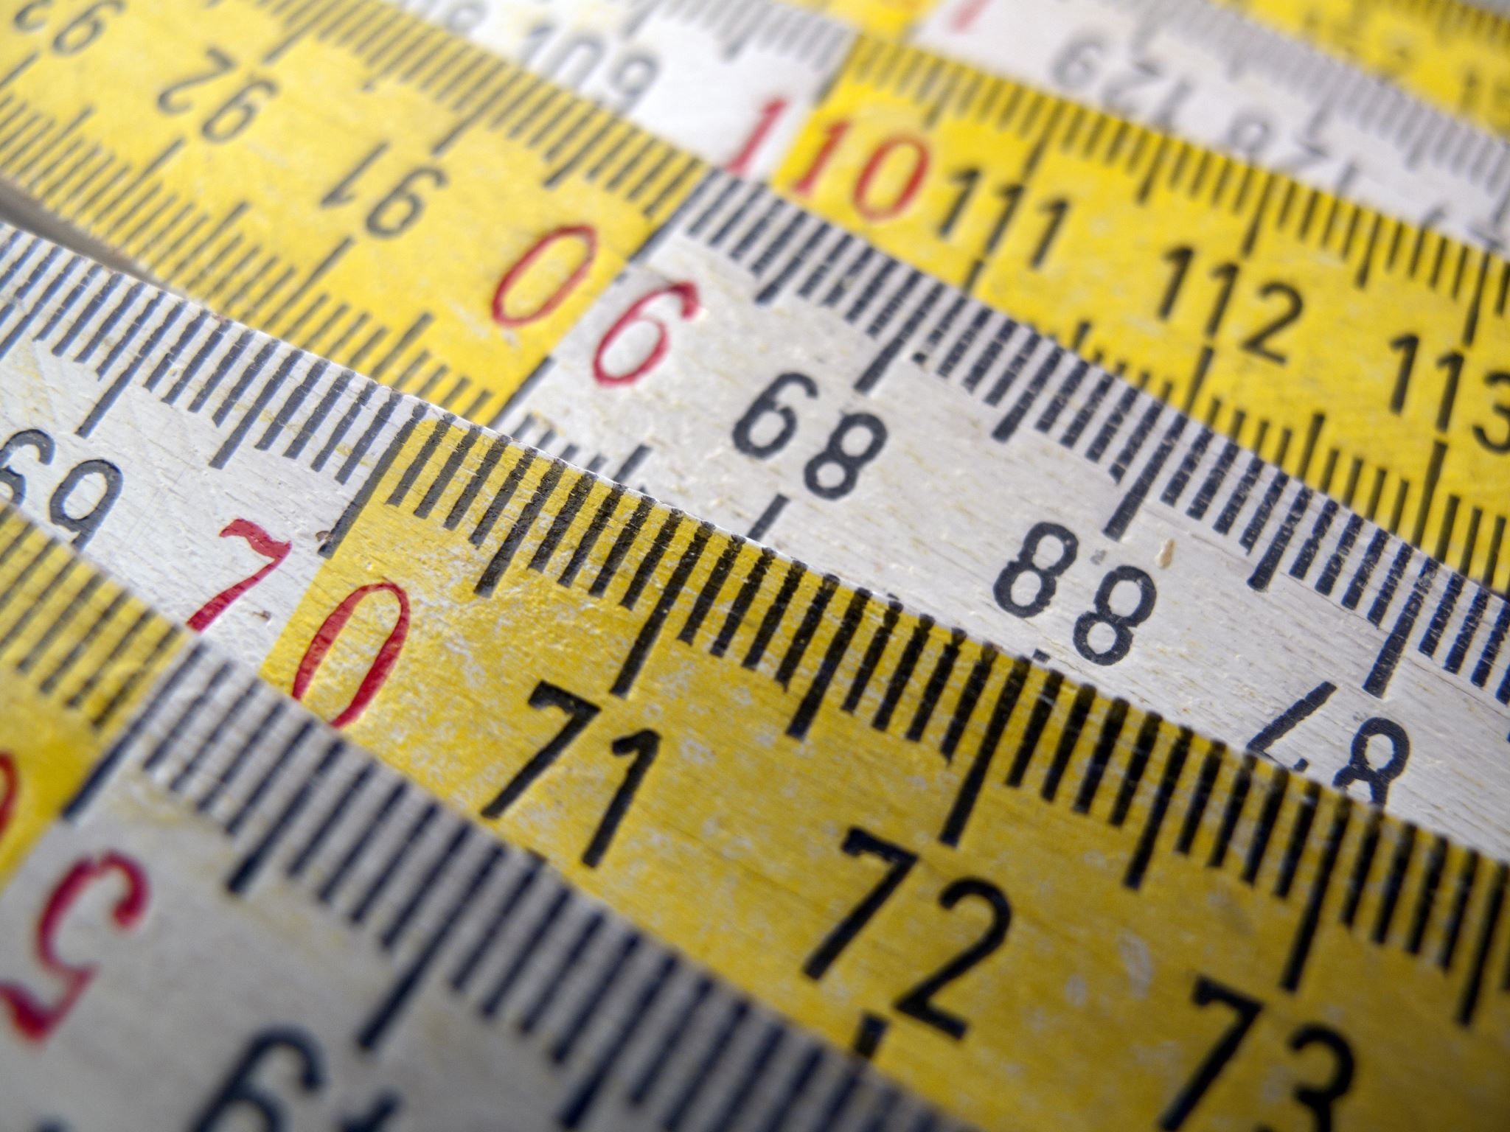
Measures
Categorical Measures
A commonly used expression for nominal and ordinal measures
Continuous measures
A commonly used expression for interval and ratio measures

Slide 8
The Avery Fitness Center (AFC) Project
Research Problems:
(1) discover existing member demographics and usage patterns (including fees paid)
(2) investigate how members initially learn about AFC
Population: AFC members who had visited AFC at least once in the prior 12 months
Simple random sample
Mail survey; 231 suable responses (58% response rate)
Primary data matched to secondary data (i.e., fees paid over prior 12 months)

Slide 9

Basic Univariate Statistics: Categorical Measures
Frequency Analysis
A count of the number of cases that fall into each of the possible response categories
An incredibility common and useful type of analysis
Notes:
Just another reminder that for categorical measure, we can present frequency analysis or frequency chart.
If you can recall our previous excel example that we count the number of males or females students.
That is frequency analysis

Slide 10
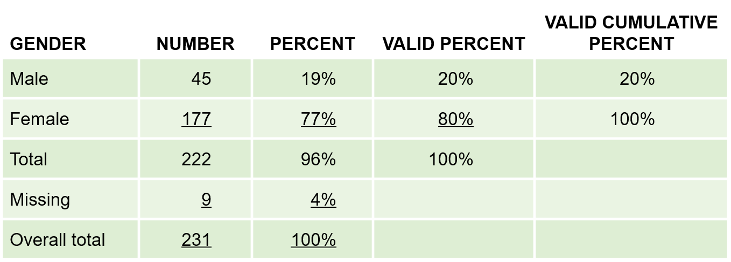
The Avery Fitness Center (AFC)
Exhibit 17.1 Avery Fitness Center: Gender
Notes:
Here is an example of the frequency analysis
Go into detail of this table

Slide 11

Use of Percentages
Percentages are very useful for interpreting the results of categorical analyses and should be included whenever possible
Unless your sample is VERY large; however, report percentages as whole numbers (i.e., no decimals)
Notes:
So percentages are very …

Slide 12
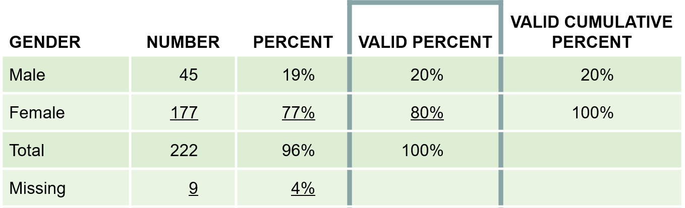
Frequency Analysis
Researchers almost always work with “valid” percentages which are simply percentages after taking out cases with missing data on the variable being analyzed
Exhibit 17.1 Avery Fitness Center: Gender
Notes:
Moreover, we as researchers almost always work explicitly with “valid” percentages, which just mean after taking out the missing data

Slide 13
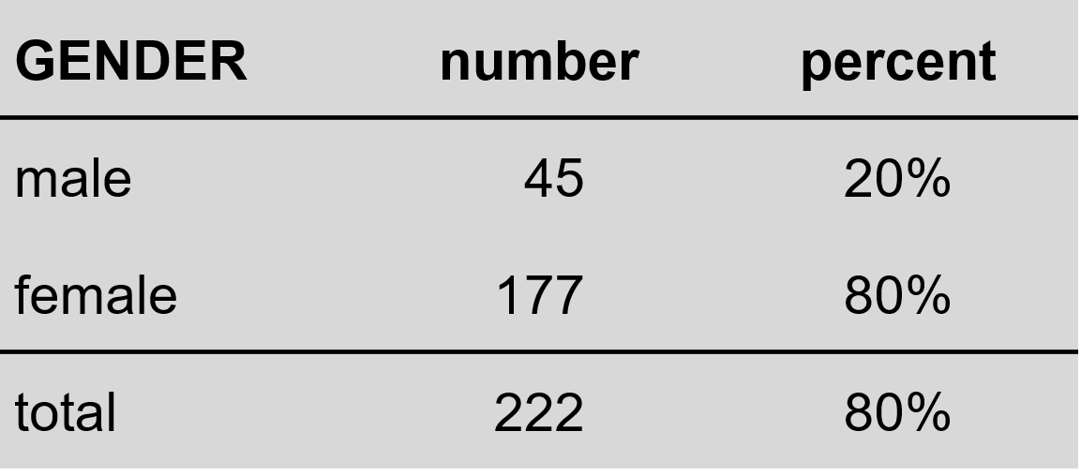
Presenting Frequency Analysis Results
(missing = 9)
Notes:
Hence, if you want to present frequency analysis in your presentation or reports,
Please present it this way

Slide 14
Uses of Frequency Analysis
Univariate categorical analysis
Identify blunders and cases
Identify outliers
Outlier: an observation so different in magnitude from the rest of the observation that the analyst chooses to treat it as a special case
Identify the median
Notes:
This slide is a just a simple cheat sheet for you to remember.
….

Slide 15
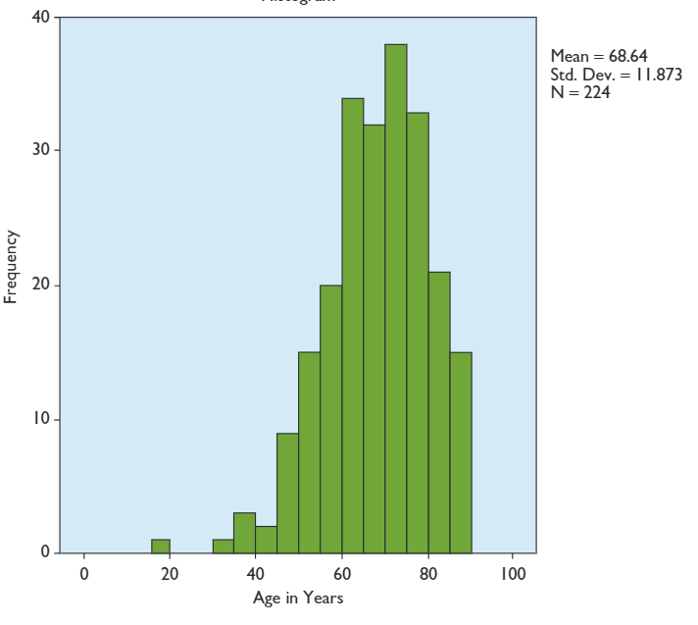
Uses of Frequency Analysis

Slide 16

Uses of Frequency Analysis
Histogram
A form of bar chart on which the values of the variable are placed along the x-axis and the absolute or relative frequency of the values is shown on the y-axis

Slide 17
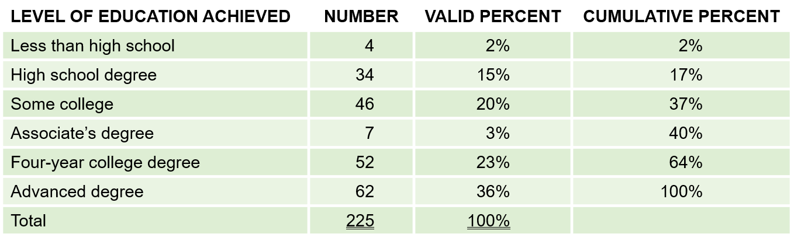
Uses of Frequency Analysis
Exhibit 17.2 Avery Fitness Center: Level of Education
The MEDIAN level of education is found by identifying the level that contains the 50th percentile in the frequency distribution.
Notes:
Open histogram to show students how to do it

Slide 18
Converting Continuous Measures to Categorial Measures
Sometimes it is useful to convert continuous measures to categorical measures
This is legitimate because measures at higher levels of measurement (in this case, continuous measures) have all the properties of measures at lower levels of measurement (categorical measures)
Why do this? Ease of interpretation
Notes:
If you recall, the higher levels of measurements have all the properties of lower levels of measurement
Mention 4 measurements.
Hence, you can convert continuous measures to categorical measures
Sometimes, we do this because it can be easier to interpret

Slide 19

Common Approaches
Common Approaches:
Judgment
Median split
Cumulative % breakdowns
Two-box technique
Notes:
Common approaches are …
Judgment is rather subjective. Hence, we typically don’t do it
I will cover median split and cumulative % breakdowns only
Two-box technique is rarely ever used in practice

Slide 20
Median Split
A technique for converting a continuous measure into a categorical measure with two approximately equal sized groups. The groups are formed by “splitting” the continuous measure at its median value
Notes:
Median split just means that we split the measurement into 2 equal sized groups.
The split happens at its median value

Slide 21

Common Approaches
The MEDIAN level of education is found by identifying the level that contains the 50th percentile in the frequency distribution
Exhibit 17.2 Avery Fitness Center: Level of Education
Notes:
For example, ….

Slide 22
Common Approaches
Using a median split will result in two education groups, a lower education group (64%; less than high school, high school degree, some college, associate’s degree, four-year college degree) and a higher education group (36%; advanced degree).
An alternative approach that would produce a more even split of AFC respondents would be to combine those with a four-year or advanced degree as the higher education group.
Notes:
Then you will have 2 groups called lower and higher education

Slide 23
CUMULATIVE PERCENTAGE BREAKDOWN
A technique for converting a continuous measure into a categorical measure. The categories are formed based on the cumulative percentages obtained in a frequency analysis.
Notes:
Relatedly, we have cumulative percentage breakdown where categories are created based on the cumulative percentages from the frequency analysis

Slide 24
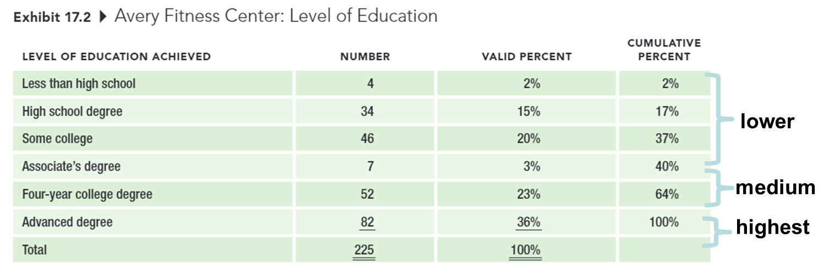
CUMULATIVE PERCENTAGE BREAKDOWN
Notes:
If we wanted three approximately equal-sized education groups instead of six, we could use the cumulative percentage breakdown to construct the groups.

Slide 25
TWO-BOX TECHNIQUE
A technique for converting an interval-level rating scale into a categorical measure, usually used for presentation purposes. The percentage of respondents choosing one of the top two positions on a rating scale is reported.

Slide 26
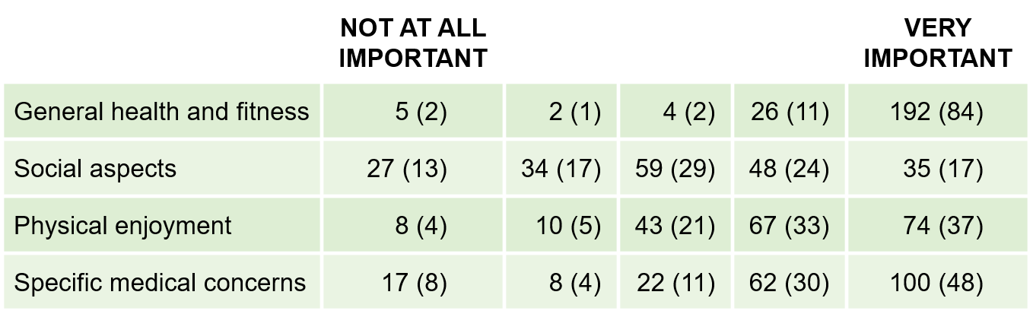
TWO-BOX TECHNIQUE
Exhibit 17.6 Avery Fitness Center: Reasons for Participation “How important to you personally is each of the following reasons for participating in AFC programs?”
Number (Percentage) of Respondents Selecting Each Response Category

Slide 27
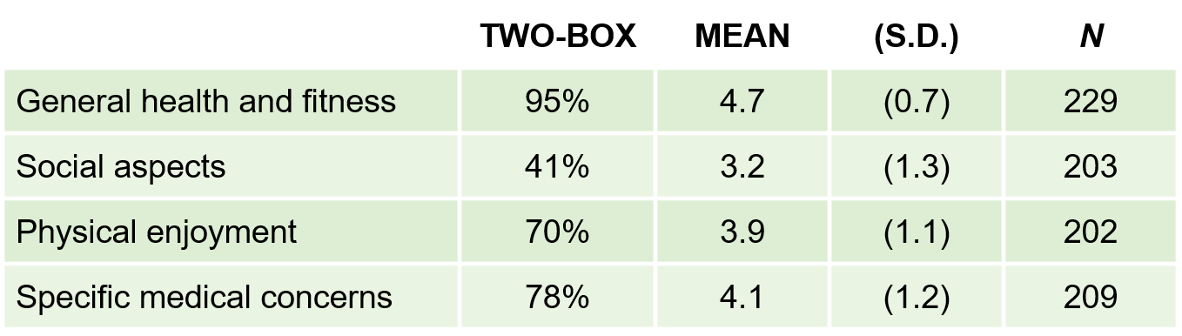
TWO-BOX TECHNIQUE
Exhibit 17.7 Avery Fitness Center: Two-Box Results, With Descriptive Statistics

Slide 28

Simple Regression
Regression Materials:
3-Correlation; regression intro
4-Simple regression
Notes:
Word doc
3 and 4

Slide 29

10-min Group Discussion
Fix Data analysis plan
Initial data analysis (Assignment 8)

Slide 30

Up next
Mid-term Evaluation (Sunday this week)
Initial Data Analysis (Sunday next week)
Multiple Regression

Slide 31

5-min snippet Sex Ratio Equilibrium
Robust ratio of 1:1
Notes:
This model investigates emergent patterns in a demographic property of a population: the adult sex ratio (ASR). ASR is defined as the ratio of males to females in the adult population. Most sexually reproducing organisms have an ASR of 1:1. Fisher (1930) explains a rationale for this phenomenon based on natural selection, irrespective of a particular mechanism of sex-determination, which is now known as Fisher’s principle (Hamilton, 1967).

